Slide 1
§10.2 Graph Terminology
You need to learn the following terms:
Adjacent, connects, endpoints, degree, initial, terminal, in-degree, out-degree, complete, cycles, wheels, n-cubes, bipartite, subgraph, union.

Slide 2
Adjacency
Let G be an undirected graph with edge set E. Let e∈E be (or map to) the pair {u,v}. Then we say:
u, v are adjacent / neighbors / connected.
Edge e is incident with vertices u and v.
Edge e connects u and v.
Vertices u and v are endpoints of edge e.

Slide 3
Neighborhood
The set of all neighbors of a vertex v of G = (V ,E), denoted by N(v), is called the neighborhood of v.
If A is a subset of V , we denote by N(A) the set of all vertices in G that are adjacent to at least one vertex in A. So,

Slide 4
Degree of a Vertex
Let G be an undirected graph, v∈V a vertex.
The degree of v, deg(v), is its number of incident edges. (Except that any self-loops are counted twice.)
A vertex with degree 0 is called isolated.
A vertex of degree 1 is called pendant.

Slide 5
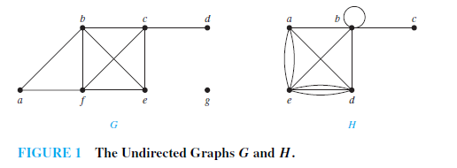
Example 1

Slide 6
Handshaking Theorem
Let G be an undirected (simple, multi-, or pseudo-) graph with vertex set V and edge set E. Then
Corollary: Any undirected graph has an even number of vertices of odd degree.

Slide 7
Directed Adjacency
Let G be a directed (possibly multi-) graph, and let e be an edge of G that is (or maps to) (u,v). Then we say:
u is adjacent to v, v is adjacent from u
e comes from u, e goes to v.
e connects u to v, e goes from u to v
the initial vertex of e is u
the terminal vertex of e is v

Slide 8
Directed Degree
Let G be a directed graph, v a vertex of G.
The in-degree of v, deg⁻(v), is the number of edges going to v.
The out-degree of v, deg⁺(v), is the number of edges coming from v.
The degree of v, deg(v):≡deg⁻(v)+deg⁺(v), is the sum of v’s in-degree and out-degree.

Slide 9
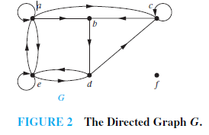
Example 4

Slide 10
Directed Handshaking Theorem
Let G be a directed (possibly multi-) graph with vertex set V and edge set E. Then:
Note that the degree of a node is unchanged by whether we consider its edges to be directed or undirected.

Slide 11
Underlying undirected graph
The undirected graph that results from ignoring directions of edges is called the underlying undirected graph.

Slide 12
Special Graph Structures
Special cases of undirected graph structures:
Complete graphs K_{n}
Cycles C_{n}
Wheels W_{n}
n-Cubes Q_{n}
Bipartite graphs
Complete bipartite graphs K_{m,n}

Slide 13
Complete Graphs
For any n∈N, a complete graph on n vertices, K_{n}, is a simple graph with n nodes in which every node is adjacent to every other node: ∀u,v∈V: u≠v↔{u,v}∈E.
K₁
K₂
K₃
K₄
K₅
K₆
Note that K_{n} has edges.

Slide 14
Cycles
For any n≥3, a cycle on n vertices, C_{n}, is a simple graph where V={v₁,v₂,… ,v_{n}} and E={{v₁,v₂},{v₂,v₃},…,{v_{n−1},v_{n}},{v_{n},v₁}}.
C₃
C₄
C₅
C₆
C₈
C₇
How many edges are there in C_{n}?

Slide 15
Wheels
For any n≥3, a wheel W_{n}, is a simple graph obtained by taking the cycle C_{n} and adding one extra vertex v_{hub} and n extra edges {{v_{hub},v₁}, {v_{hub},v₂},…,{v_{hub},v_{n}}}.
W₃
W₄
W₅
W₆
W₈
W₇
How many edges are there in W_{n}?

Slide 16
n-cubes (hypercubes)
For any n∈N, the hypercube Q_{n} is a simple graph consisting of two copies of Q_{n-1} connected together at corresponding nodes. Q₀ has 1 node.
Q₀
Q₁
Q₂
Q₄
Q₃
Number of vertices: 2^{n}. Number of edges:Exercise to try!

Slide 17
n-cubes (hypercubes)
For any n∈N, the hypercube Q_{n} can be defined recursively as follows:
Q₀={{v₀},∅} (one node and no edges)
For any n∈N, if Q_{n}=(V,E), where V={v₁,…,v_{a}} and E={e₁,…,e_{b}}, then Q_{n+1}=(V∪{v₁´,…,v_{a}´}, E∪{e₁´,…,e_{b}´}∪{{v₁,v₁´},{v₂,v₂´},…, {v_{a},v_{a}´}}) where v₁´,…,v_{a}´ are new vertices, and where if e_{i}={v_{j},v_{k}} then e_{i}´={v_{j}´,v_{k}´}.

Slide 18
Bipartite Graphs
Def’n.: A graph G=(V,E) is bipartite (two-part) iff V = V₁ ∪ V₂ where V₁ ∩ V₂=∅ and ∀e∈E: ∃v₁∈V₁,v₂∈V₂: e={v₁,v₂}.
In English: The graph can be divided into two parts in such a way that all edges go between the two parts.
V₁
V₂
This definition can easily be adapted for the case of multigraphs and directed graphs as well.
Can represent with zero-one matrices.

Slide 19
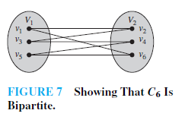
Example 9

Slide 20
Example 10
K₃ is not bipartite.

Slide 21
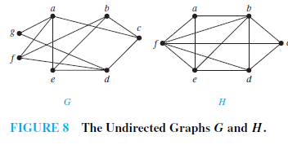
Example 11
Are the graphs G and H displayed in Figure 8 bipartite?

Slide 22
Theorem
A simple graph is bipartite if and only if it is possible to assign one of two different colors to each vertex of the graph so that no two adjacent vertices are assigned the same color.

Slide 23
Complete Bipartite Graphs
For m,n∈N, the complete bipartite graph K_{m,n} is a bipartite graph where |V₁| = m, |V₂| = n, and E = {{v₁,v₂}|v₁∈V₁ ∧ v₂∈V₂}.
That is, there are m nodes in the left part, n nodes in the right part, and every node in the left part is connected to every node in the right part.
K_{4,3}
K_{m,n} has _____ nodes and _____ edges.

Slide 24
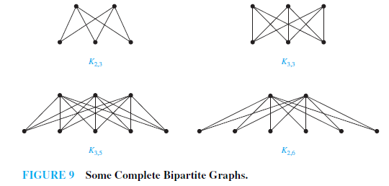

Slide 25
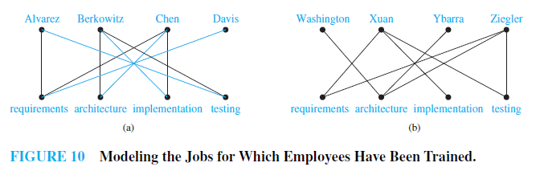
Bipartite Graphs and Matchings
Job Assignments

Slide 26
A matching M in a simple graph G = (V ,E) is a subset of the set E of edges of the graph such that no two edges are incident with the same vertex.
A vertex that is the endpoint of an edge of a matching M is said to be matched in M; otherwise it is said to be unmatched.
A maximum matching is a matching with the largest number of edges.
A matching M in a bipartite graph G = (V ,E) with bipartition (V₁, V₂) is a complete matching from V₁ to V₂ if every vertex in V₁ is the endpoint of an edge in the matching, or equivalently, if |M| = |V₁|.

Slide 27
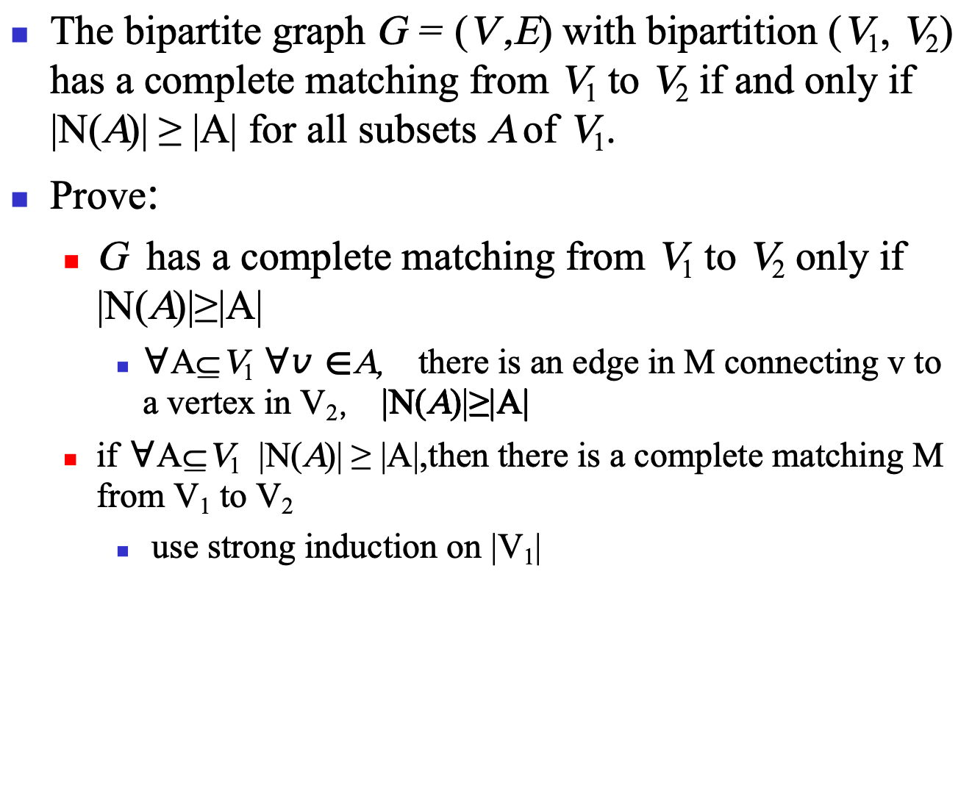
HALL’S MARRIAGE THEOREM-1
The bipartite graph G = (V ,E) with bipartition (V₁, V₂) has a complete matching from V₁ to V₂ if and only if |N(A)| ≥ |A| for all subsets A of V₁.
Prove:
G has a complete matching from V₁ to V₂ only if |N(A)|≥|A|
$∀$A⊆V₁ $∀v∈$A， there is an edge in M connecting v to a vertex in V₂， |N(A)|≥|A|
if$∀$A⊆V₁ |N(A)| ≥ |A|,then there is a complete matching M from V₁ to V₂
use strong induction on |V₁|

Slide 28
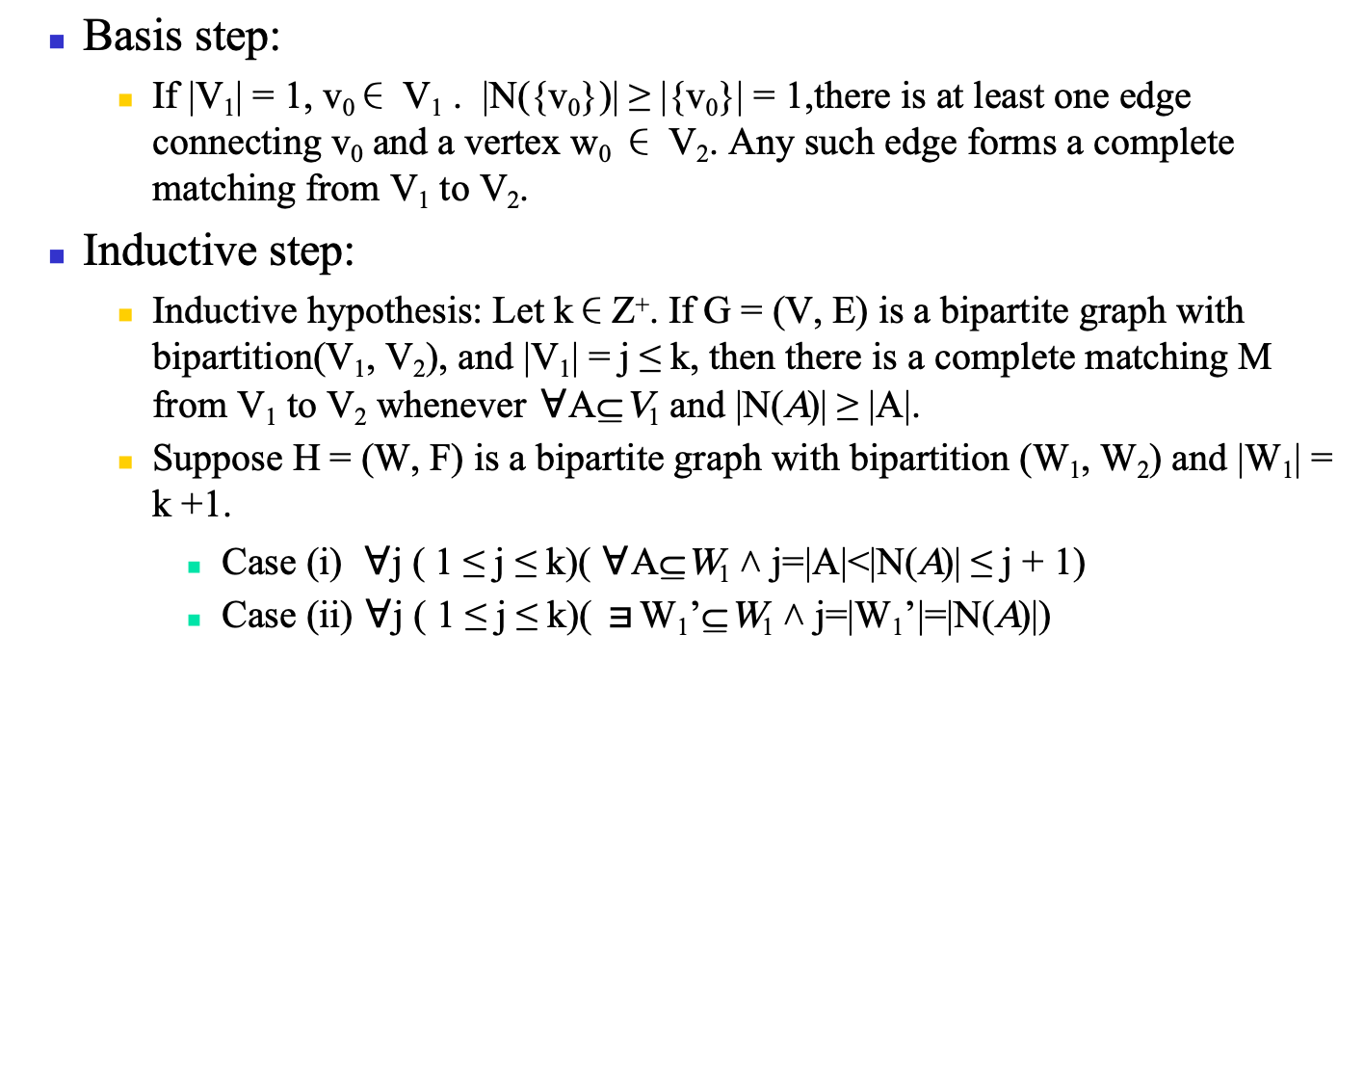
HALL’S MARRIAGE THEOREM-2
Basis step:
If |V₁| = 1, v₀∈ V₁ . |N({v₀})| ≥ |{v₀}| = 1,there is at least one edge connecting v₀ and a vertex w₀ ∈ V₂. Any such edge forms a complete matching from V₁ to V₂.
Inductive step:
Inductive hypothesis: Let k∈Z⁺. If G = (V, E) is a bipartite graph with bipartition(V₁, V₂), and |V₁| = j ≤ k, then there is a complete matching M from V₁ to V₂ whenever$∀$A⊆V₁ and |N(A)| ≥ |A|.
Suppose H = (W, F) is a bipartite graph with bipartition (W₁, W₂) and |W₁| = k +1.
Case (i) $∀$j ( 1 ≤ j ≤ k)( $∀$A⊆W₁ ˄ j=|A|<|N(A)| ≤ j + 1)
Case (ii) $∀$j ( 1 ≤ j ≤ k)( ョW₁’⊆W₁ ˄ j=|W₁’|=|N(A)|)

Slide 29
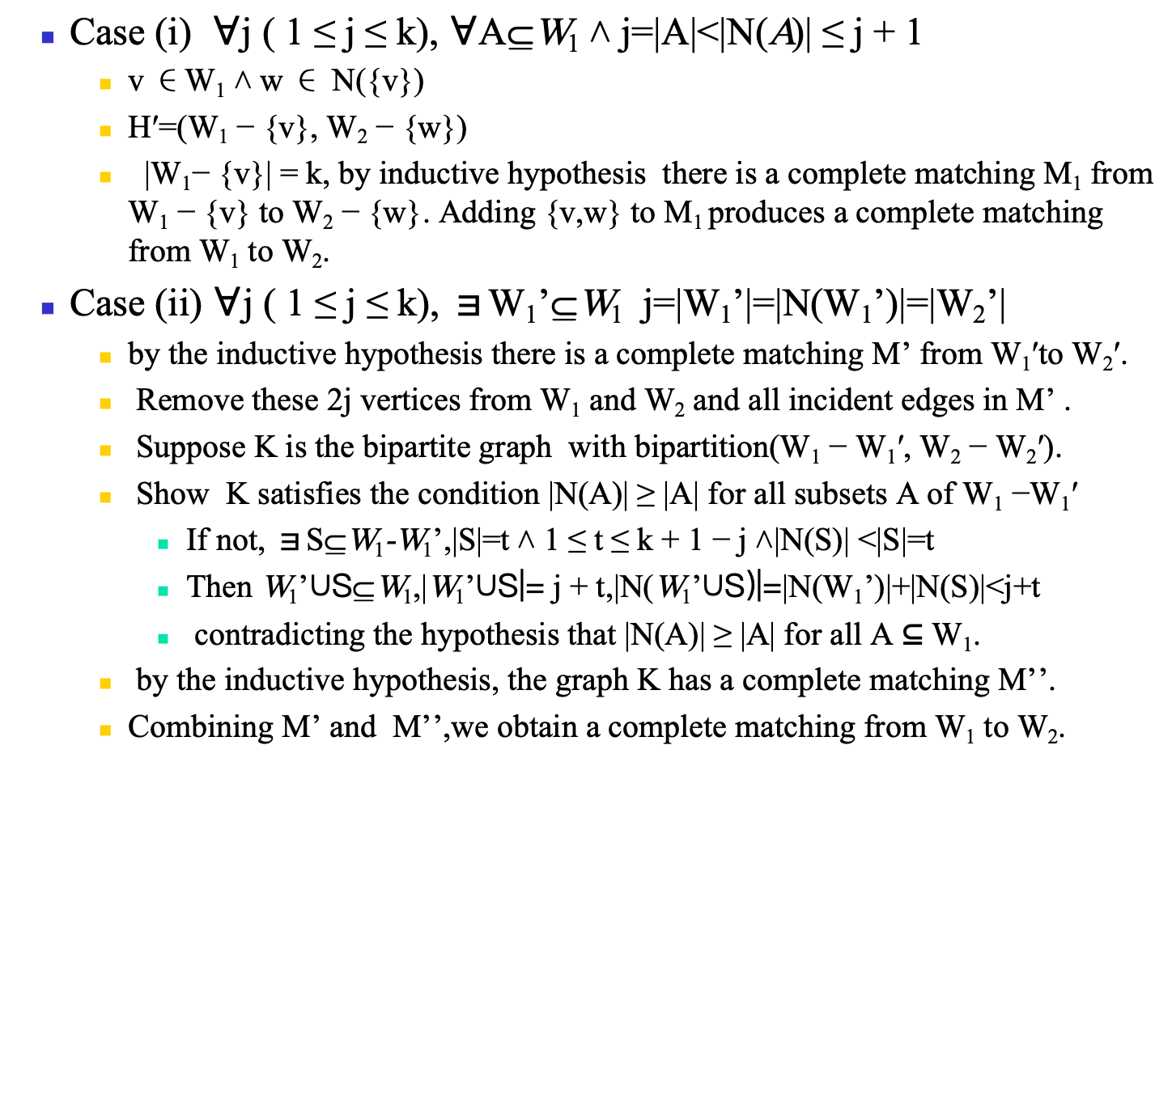
HALL’S MARRIAGE THEOREM-3
Case (i) $∀$j ( 1 ≤ j ≤ k), $∀$A⊆W₁ ˄ j=|A|<|N(A)| ≤ j + 1
v ∈W₁ ˄ w ∈ N({v})
H′=(W₁ − {v}, W₂ − {w})
|W₁− {v}| = k, by inductive hypothesis there is a complete matching M₁ from W₁ − {v} to W₂ − {w}. Adding {v,w} to M₁ produces a complete matching from W₁ to W₂.
Case (ii) $∀$j ( 1 ≤ j ≤ k), ョW₁’⊆W₁ j=|W₁’|=|N(W₁’)|=|W₂’|
by the inductive hypothesis there is a complete matching M’ from W₁′to W₂′.
Remove these 2j vertices from W₁ and W₂ and all incident edges in M’ .
Suppose K is the bipartite graph with bipartition(W₁ − W₁′, W₂ − W₂′).
Show K satisfies the condition |N(A)| ≥ |A| for all subsets A of W₁ −W₁′
If not, ョS⊆W₁-W₁’,|S|=t ˄ 1 ≤ t ≤ k + 1 − j ˄|N(S)| <|S|=t
Then W₁’∪S⊆W₁,|W₁’∪S|= j + t,|N(W₁’∪S)|=|N(W₁’)|+|N(S)|<j+t
contradicting the hypothesis that |N(A)| ≥ |A| for all A ⊆ W₁.
by the inductive hypothesis, the graph K has a complete matching M’’.
Combining M’ and M’’,we obtain a complete matching from W₁ to W₂.

Slide 30
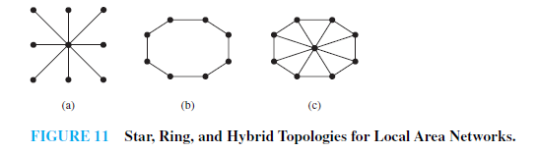
Local Area Networks

Slide 31

Interconnection Networks for Parallel Computation

Slide 32
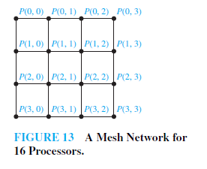

Slide 33
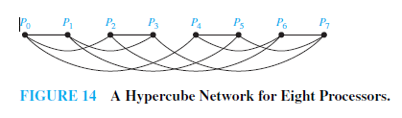

Slide 34
Subgraphs
A subgraph of a graph G=(V,E) is a graph H=(W,F) where W⊆V and F⊆E.
A subgraph H of G is a proper subgraph of G if H ≠ G.
G
H

Slide 35
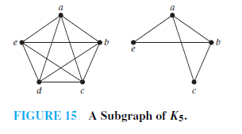

Slide 36
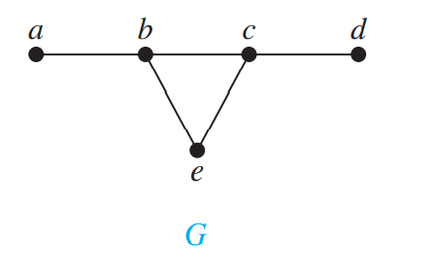
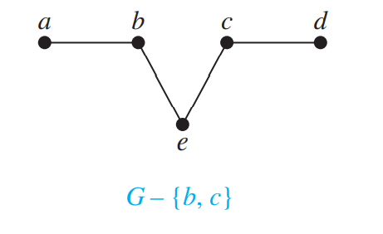
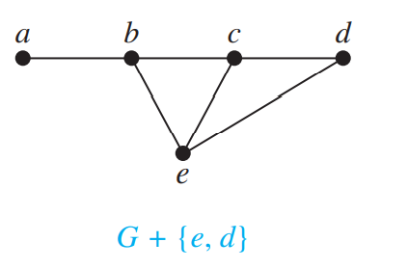
REMOVING OR ADDING EDGES OF A GRAPH
G − e = (V, E − {e})
G + e = (V, E ∪ {e})

Slide 37
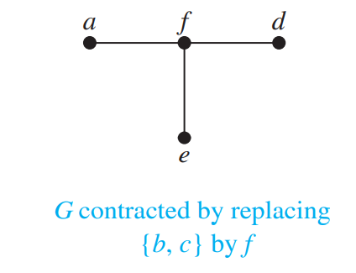
EDGE CONTRACTIONS

Slide 38
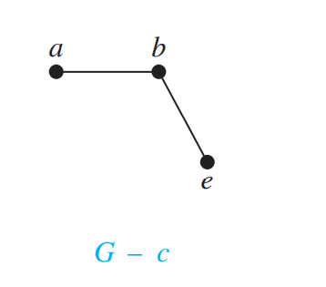
REMOVING VERTICES FROM A GRAPH

Slide 39
Graph Unions
The union G₁∪G₂ of two simple graphs G₁=(V₁, E₁) and G₂=(V₂,E₂) is the simple graph (V₁∪V₂, E₁∪E₂).
a
b
c
∪
a
b
c
d
e
d
f

Slide 40
Homework
§10.2
12, 44, 66, 74

